Slide 1
Quick Sort

Slide 2
Example -:Quick Sort
44 33 11 55 77 90 40 60 99 22 88 66
22 33 11 55 77 90 40 60 99 44 88 66
22 33 11 44 77 90 40 60 99 55 88 66
22 33 11 40 77 90 44 60 99 55 88 66
22 33 11 40 44 90 77 60 99 55 88 66
22 33 11 40 44 90 77 60 99 55 88 66

Slide 3
(Quick Sort) This algorithm sorts an array A with N elements
TOP : = NULL
If N > 1 then : TOP := TOP + 1, LOWER[TOP] := 0, UPPER[TOP]:=N-1
Repeat steps 4 to 7 while TOP != NULL
POP sublist from array Set BEG := LOWER[TOP] , END := UPPER[TOP], TOP :=Top – 1
Call QUICK(A,N,BEG,END,LOC)
If BEG < LOC – 1 then: TOP := TOP + 1 , LOWER[TOP] := BEG, UPPER[TOP] := LOC – 1
If LOC + 1 < END then: TOP := TOP + 1 ,LOWER[TOP] := LOC + 1, UPPER[TOP] := END
EXIT

Slide 4
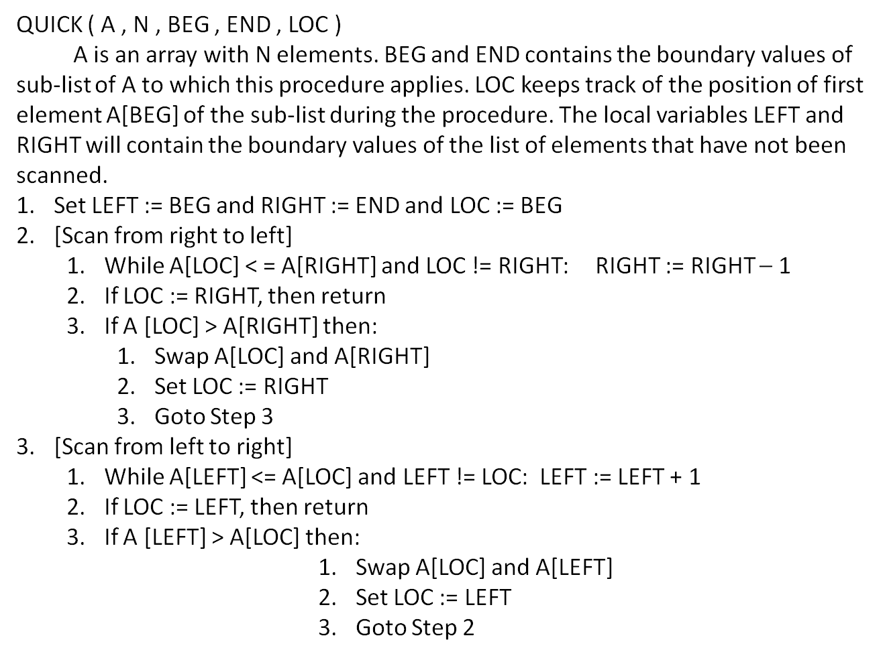

Slide 5
Examples
19 65 35 21 78 28 87 52 59
22 33 11 44 77 90 40 60 99 55 88 66

Slide 6

Complexity

